Slide 1

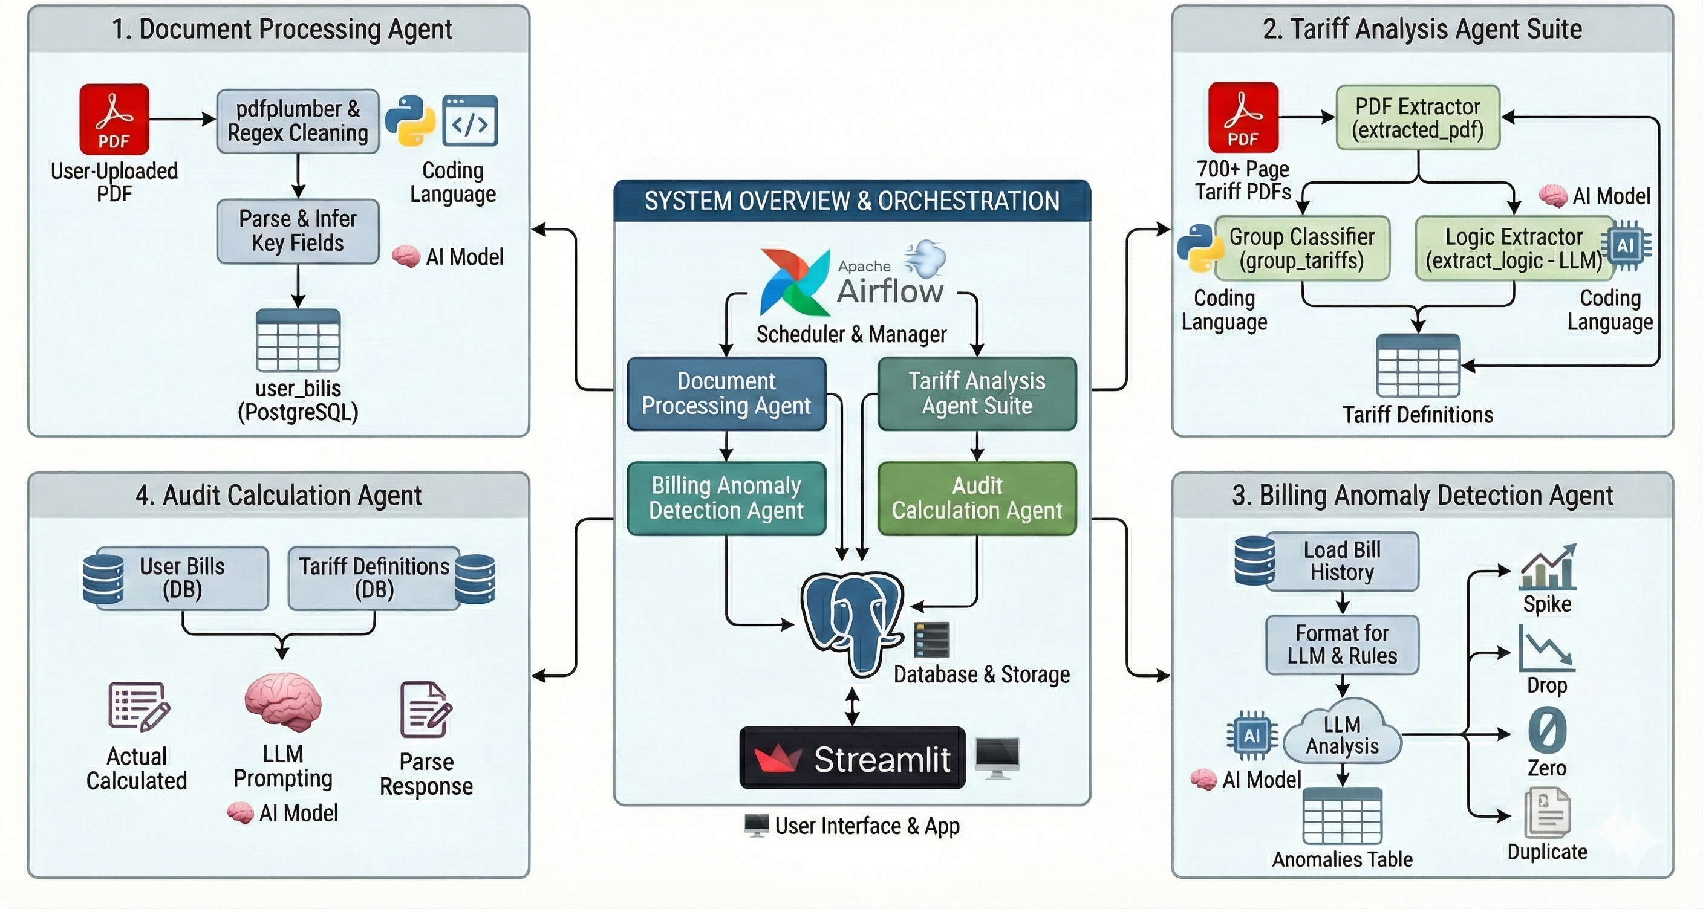
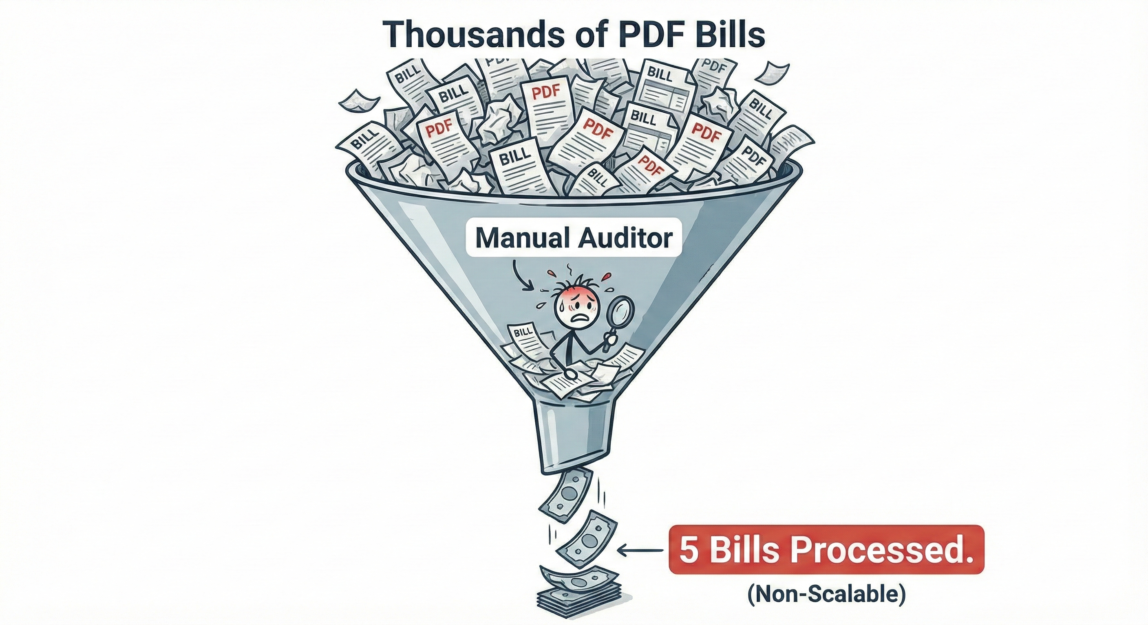
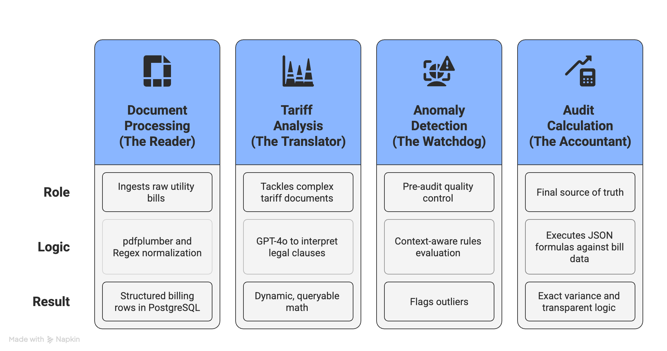
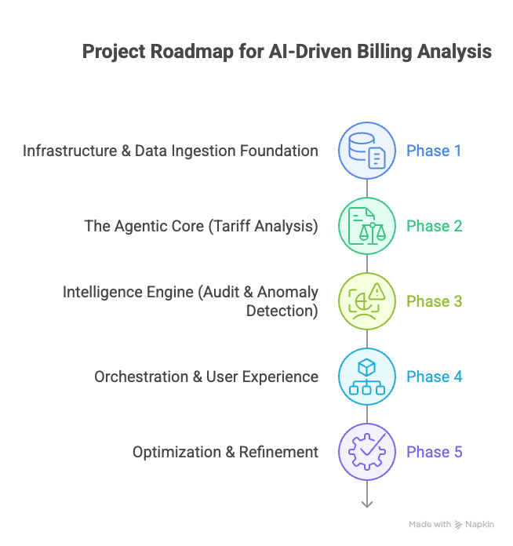
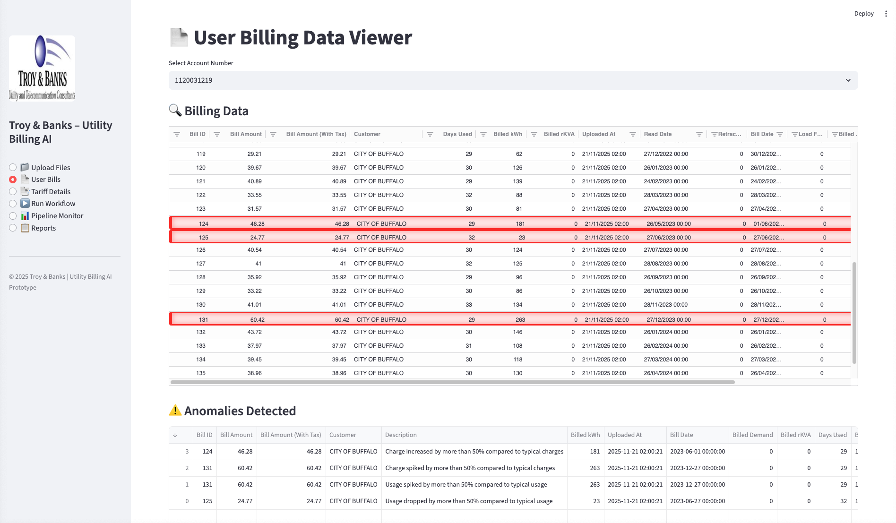
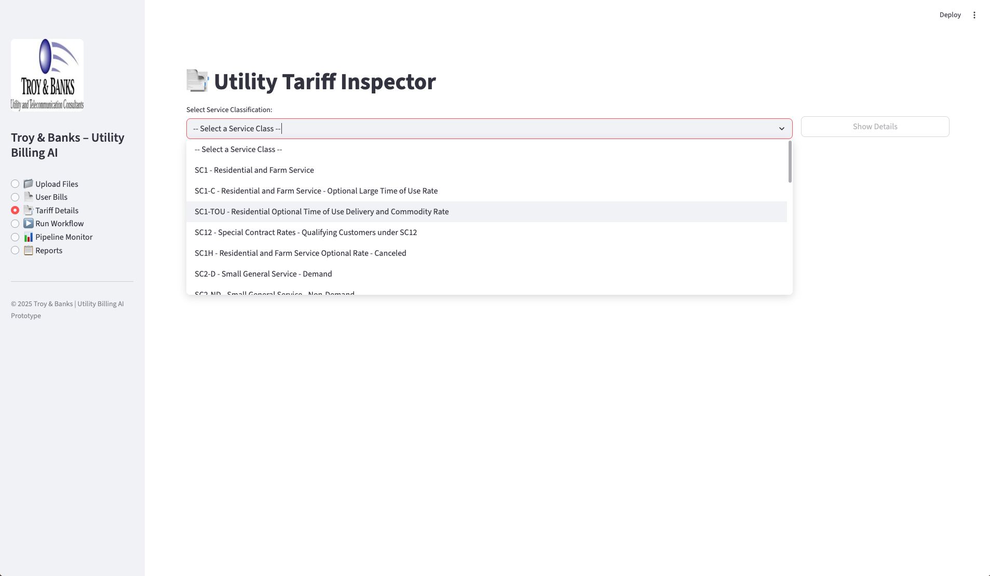
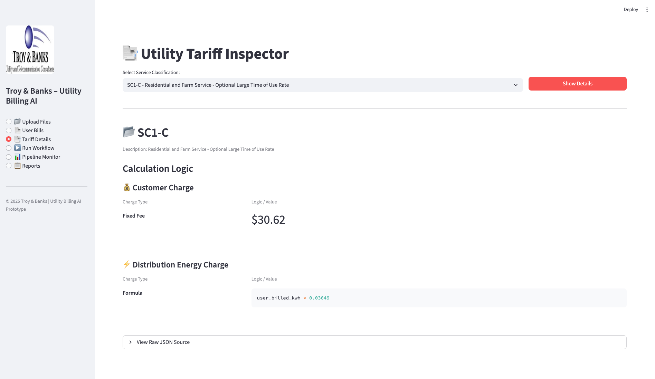
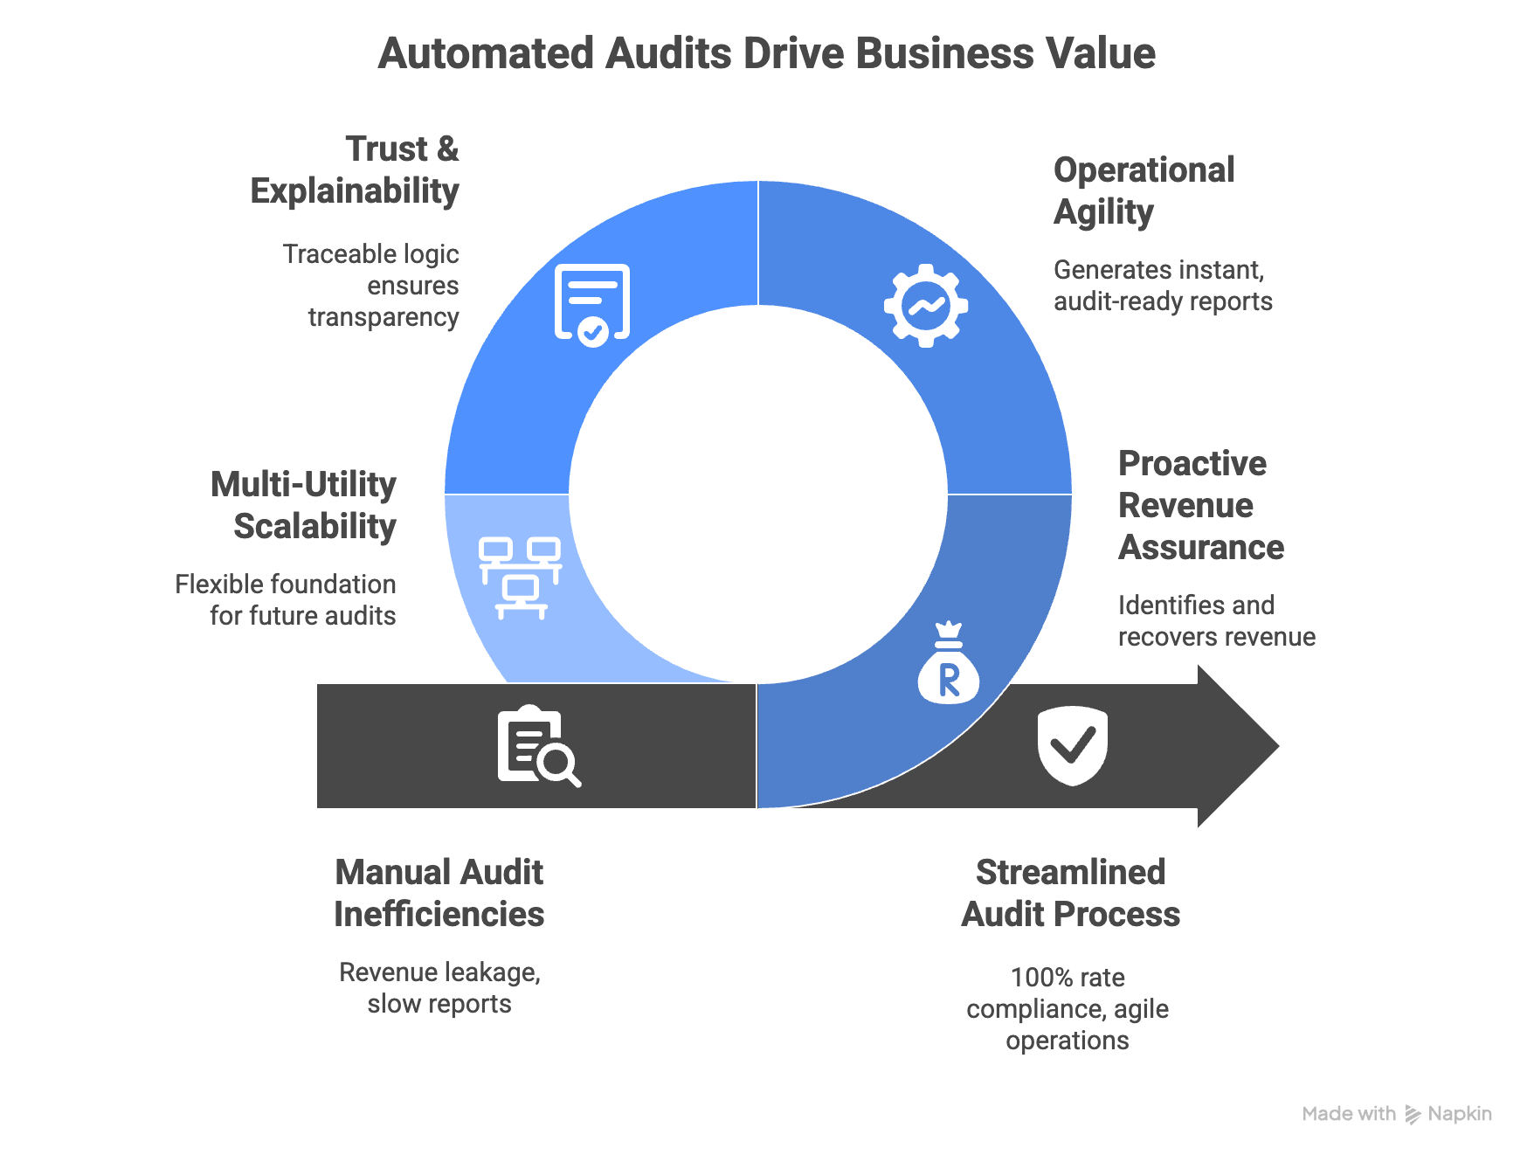
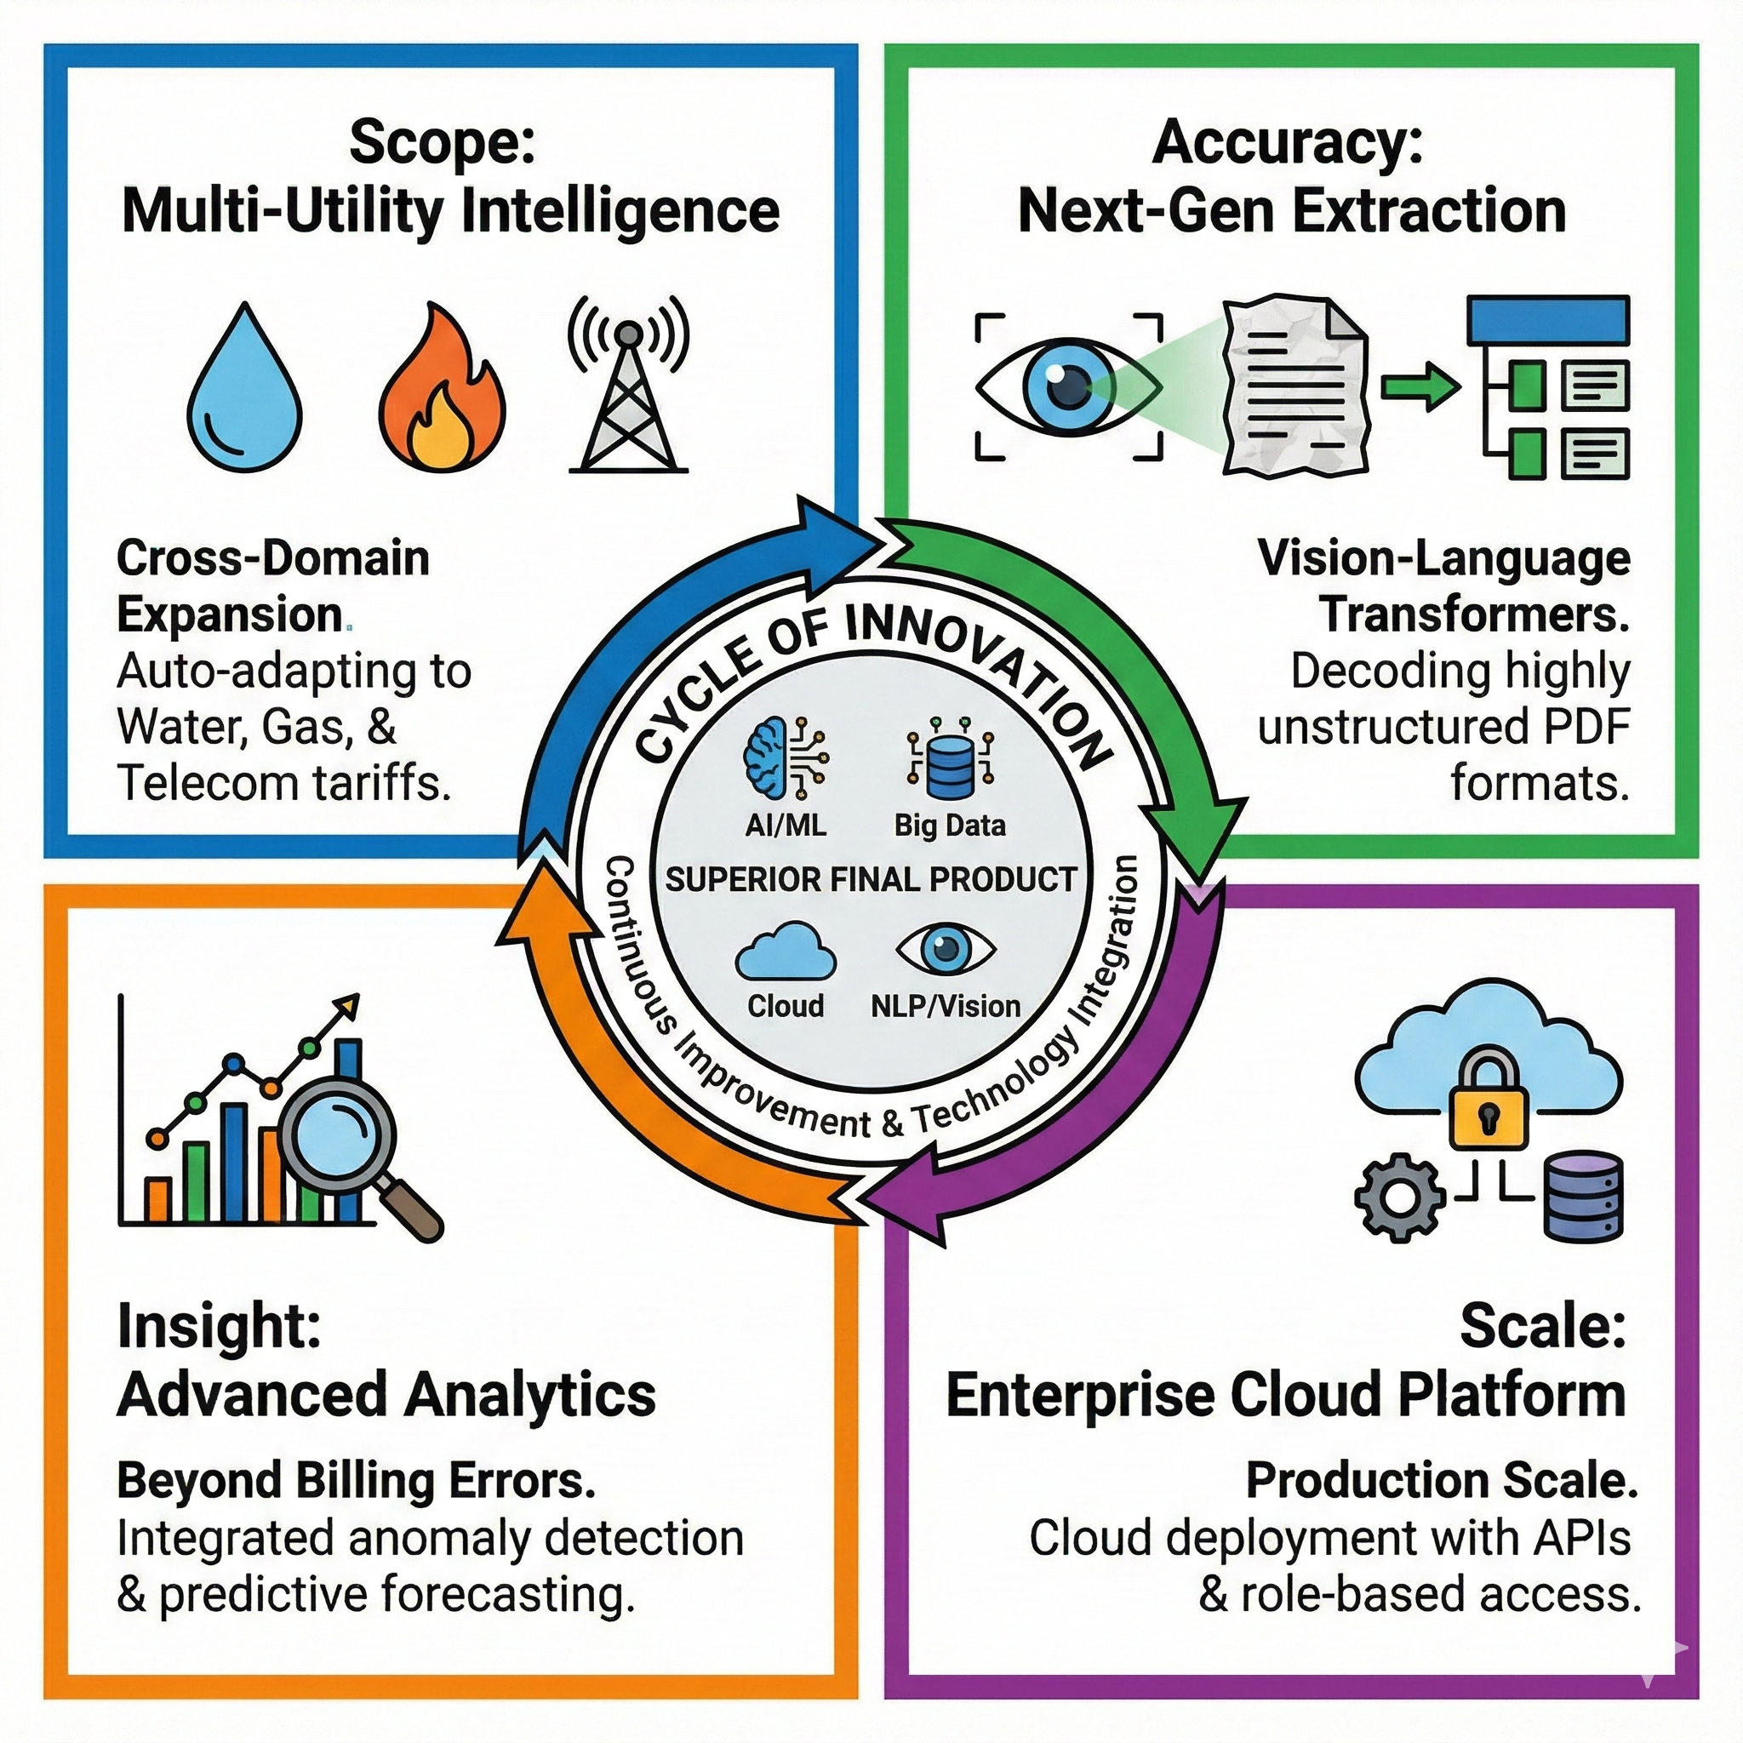






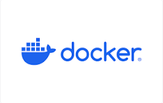

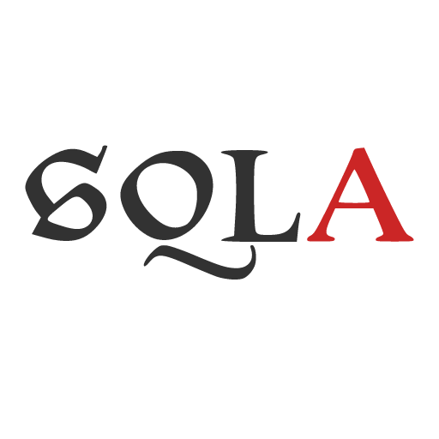



AI-Driven Utility Billing Automation: Scalable Auditing with Dynamic Tariff Engines
Transforming Manual Energy Auditing with Multi-Agent Systems and LLMs
Team : EagleEye
Harshal Patil, Avipsa Bhujabal, Aarushi Jugran
Mentors:
Prof. Adithya Narayanan, Prof. Saverio Marrazzo
THE CHALLENGE :
SYSTEM ARCHITECTURE:
OUR HYBRID APPROACH :
The Manual Bottleneck Utility auditing is a highly specialized, labor-intensive process that resists traditional automation due to data complexity.
Unscalable Workflow: Human experts require 2-4 hours to process a single complex municipal bill.
Capacity Cap: Operational limits restrict output to just 5-10 bills per day per auditor.
Data Heterogeneity:
Bills: Thousands of formats across different utility providers and service classes.
Tariffs: Pricing rules are buried in 700+ page PDF legal documents, making simple "regex" extraction impossible.
Rules + LLM Hybrid Model: Ensures both deterministic validation for accuracy and contextual reasoning for complex scenarios.
Dynamic Tariff Engine: Supports yearly changes and updates instantly without requiring code modification.
Explainable AI (XAI): Unlike "black box" systems, generates a transparent Logic Trace for every calculation, ensuring audits are legally defensible.
Instant Scalability: Decouples logic extraction from calculation, allowing the system to process thousands of accounts instantly.
Context-Aware Anomaly Detection: Automatically flags billing deviations and complex issues like Load Factor swings or sudden usage drops accompanied by cost spikes.
AGENTIC PIPELINE :
PROJECT ROADMAP :
The Input & Translation
The Validation & Audit
1
2
3
4
DASHBOARDS :
Automated anomaly detection with transparent bill visualization and audit-ready insights.
Multi-class tariff explorer with complete support for residential, commercial, and special-contract rates.
Real-time tariff breakdown—turning complex rate structures into simple, explainable logic.
BUSINESS IMPACT :
CONCLUSION :
FUTURE ENHANCEMENTS :
Revenue Assurance: Proactively identifies revenue leakage and ensures 100% rate compliance, recovering costs that manual audits miss.
Operational Agility: Dramatically reduces audit time by eliminating manual tariff lookups and generates audit-ready reports instantly, freeing analysts for high-value strategy.
Trust & Explainability: "Glass-box" architecture provides traceable logic for every calculation, ensuring outputs are defensible and transparent.
Multi-Utility Scalability: Establishes a flexible foundation ready to scale beyond electric into gas, water, and telecom audits.
Modernization: Replaced manual review with AI extraction and dynamic rule engines.
Scalability: Delivers immediate accuracy and dramatic time savings.
Strategic Value: Transforms the client from a reactive manual auditor into a proactive, data-driven financial consultancy.
TECH STACK :
. . . . .
Institute for Artificial Intelligence and Data Science
School of Engineering and Applied Science
Acknowledgements
Justin Raybeck, Energy Auditor/Advisor; Troy & Banks, Inc.
Kevin Gibbs, Vice President of Strategic Partnerships; Troy & Banks, Inc.

Slide 2
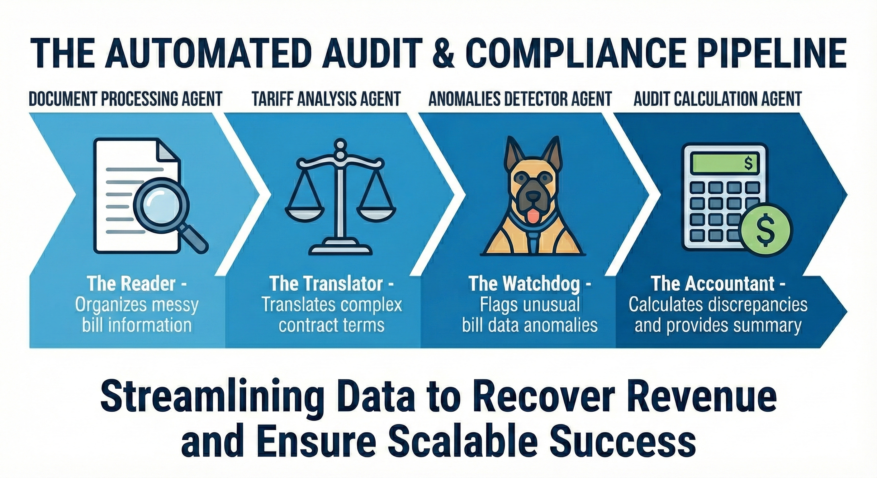
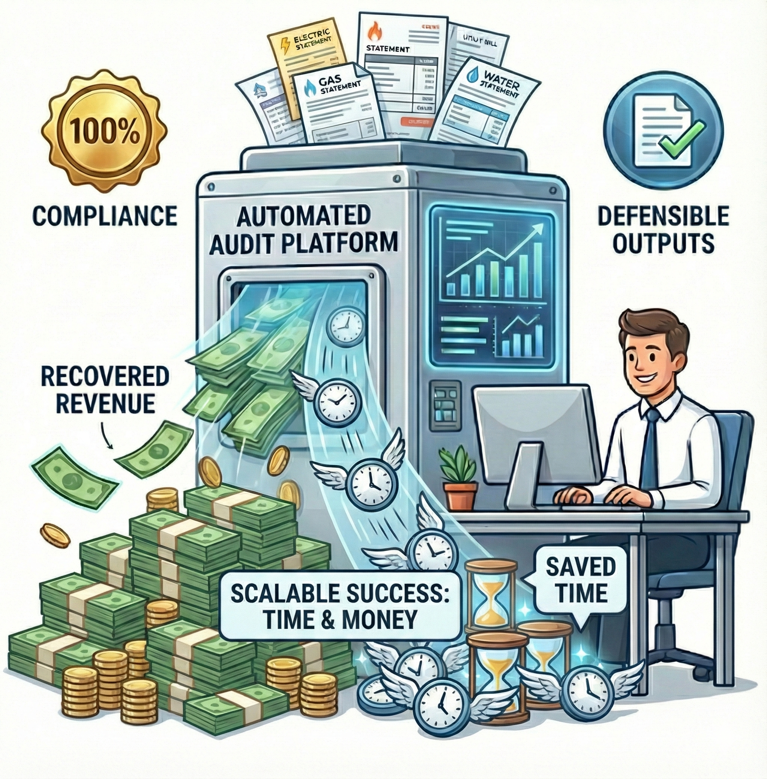
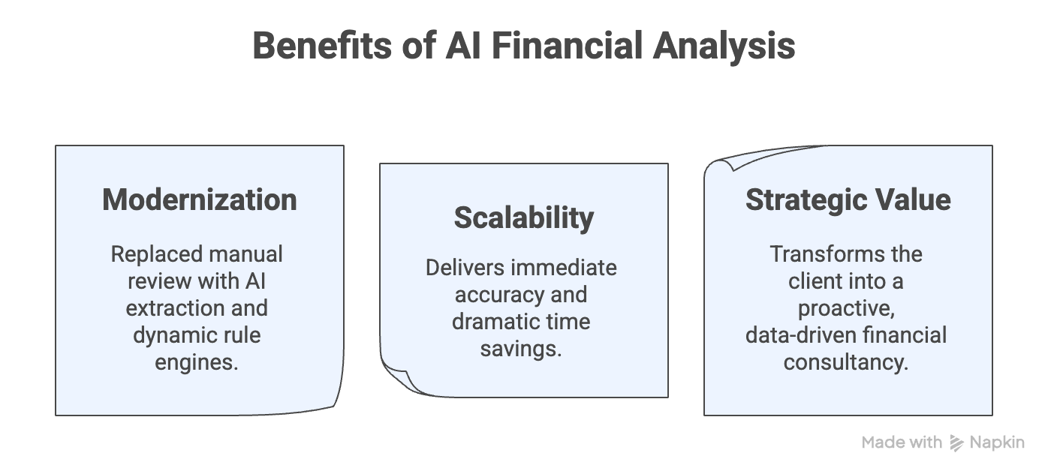
AI-Driven Utility Billing Automation:
Scalable Auditing with Dynamic Tariff Engines
Transforming Manual Energy Auditing with Multi-Agent Systems and LLMs
Team : EagleEye
Harshal Patil, Avipsa Bhujabal, Aarushi Jugran
Acknowledgements:
Kevin Gibbs, Vice President of Strategic Partnerships; Troy & Banks, Inc.
Justin Raybeck, Energy Auditor/Advisor ; Troy & Banks, Inc.
THE CHALLENGE :
SYSTEM ARCHITECTURE:
Utility auditing is a highly specialized, labor-intensive process that resists traditional automation due to data complexity.
Unscalable Workflow: Human experts require 2-4 hours to process a single complex municipal bill.
Capacity Cap: Operational limits restrict output to just 5-10 bills per day per auditor.
Data Heterogeneity:
Bills: Thousands of formats across different utility providers and service classes.
Tariffs: Pricing rules are buried in 700+ page PDF legal documents, making simple "regex" extraction impossible.
The Manual Bottleneck :
Our Agentic Pipeline:
Scalable Business Value :
DASHBOARD :
Smart Billing Audit & Visualization
Universal Tariff Explorer
Instant Tariff Logic
Impact Summary:
Voice of Our Client:
TECH STACK :
. . . . .
Institute for Artificial Intelligence and Data Science
School of Engineering and Applied Science
Mentors: :
Prof. Adithya Narayanan,
Prof. Saverio Marrazzo

